Slide 1


Slide 2

What is Pandas?
Nothing to do with the cute animal (unfortunately)
Its name comes from the econometrics term of “panel data”
Pandas is a library in python used for data manipulation and analysis

Slide 3
Pandas Features
A pandas data type can be a series only in dimension
Think of it like a list or an array
Data frame a 2-dimensional data type, a collection of different series
Like a spreadsheet

Slide 4
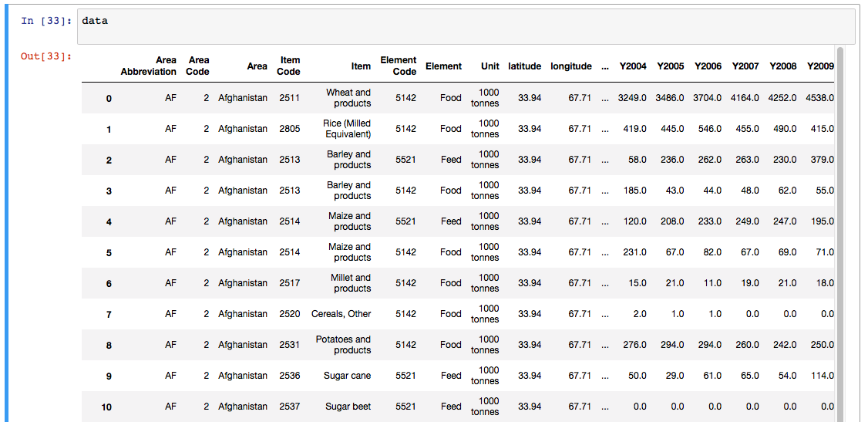
Pandas Features

Slide 5
Meteostat

Slide 6
from meteostat import Point, Hourly, Daily
import datetime
import pandas as pd
import numpy as np
import matplotlib.pyplot as plt

Slide 7
start_time = datetime.datetime(2024, 12, 25)

Slide 8


Slide 9
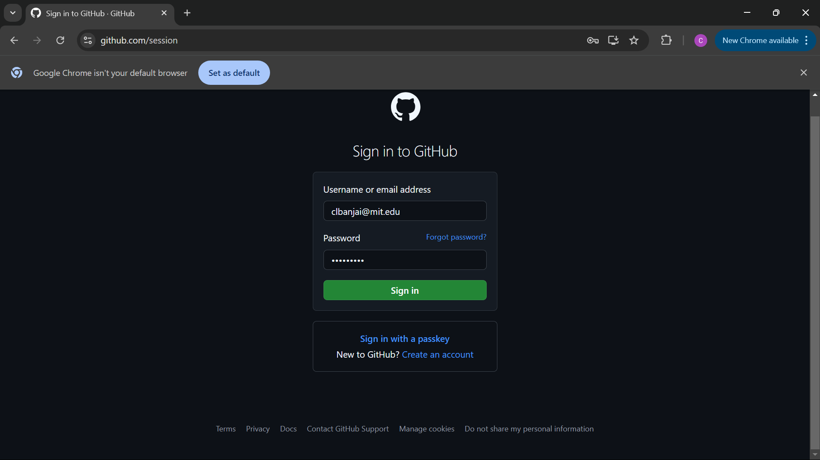

Slide 10
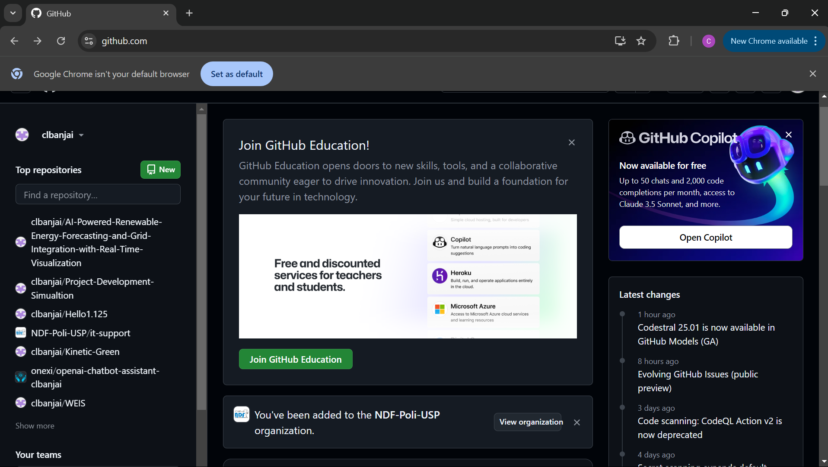

Slide 11
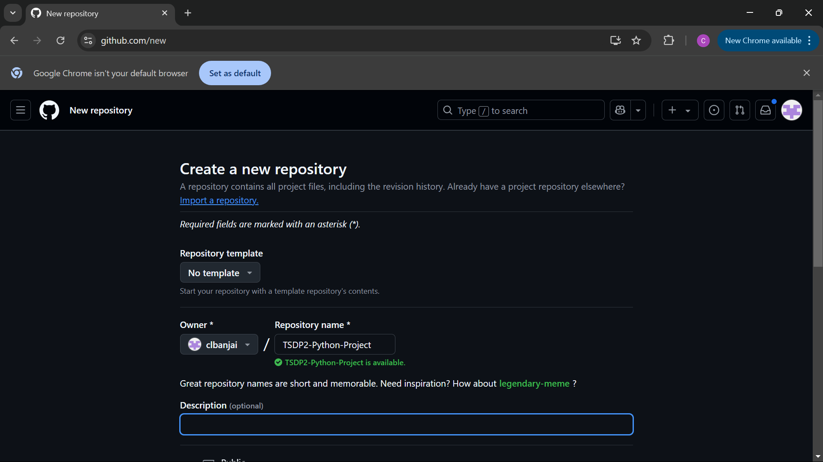

Slide 13
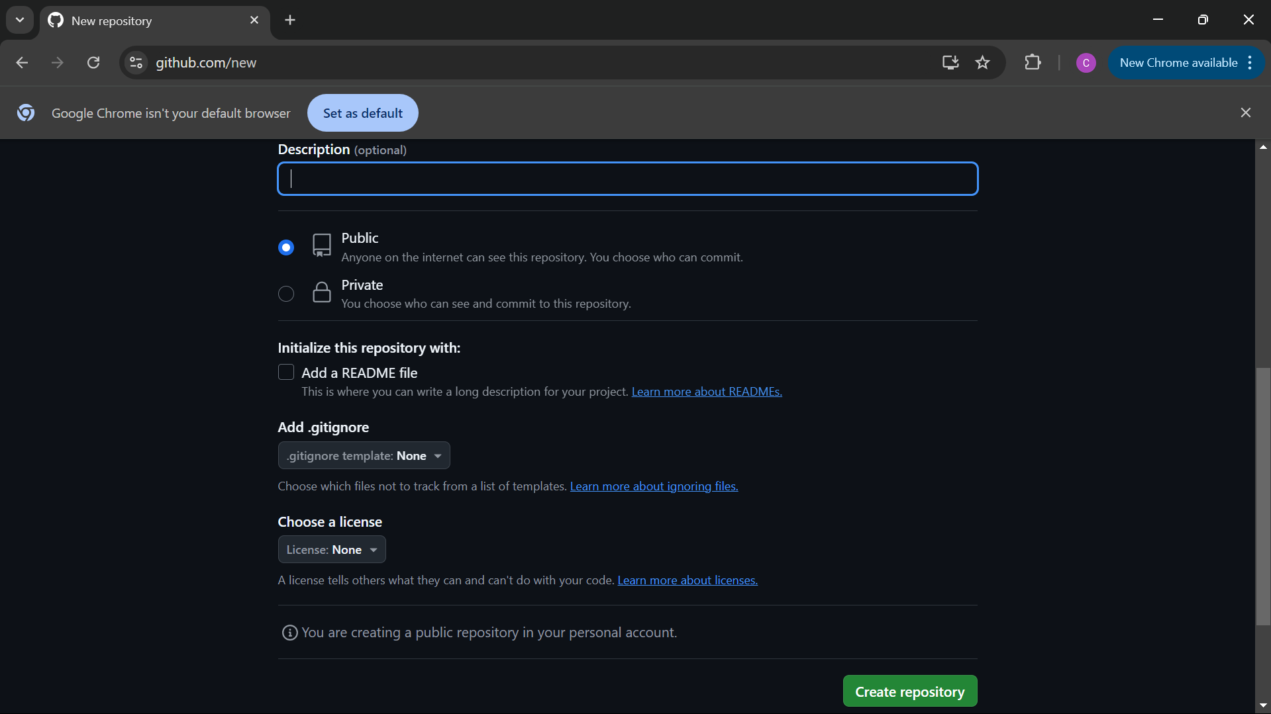

Slide 14
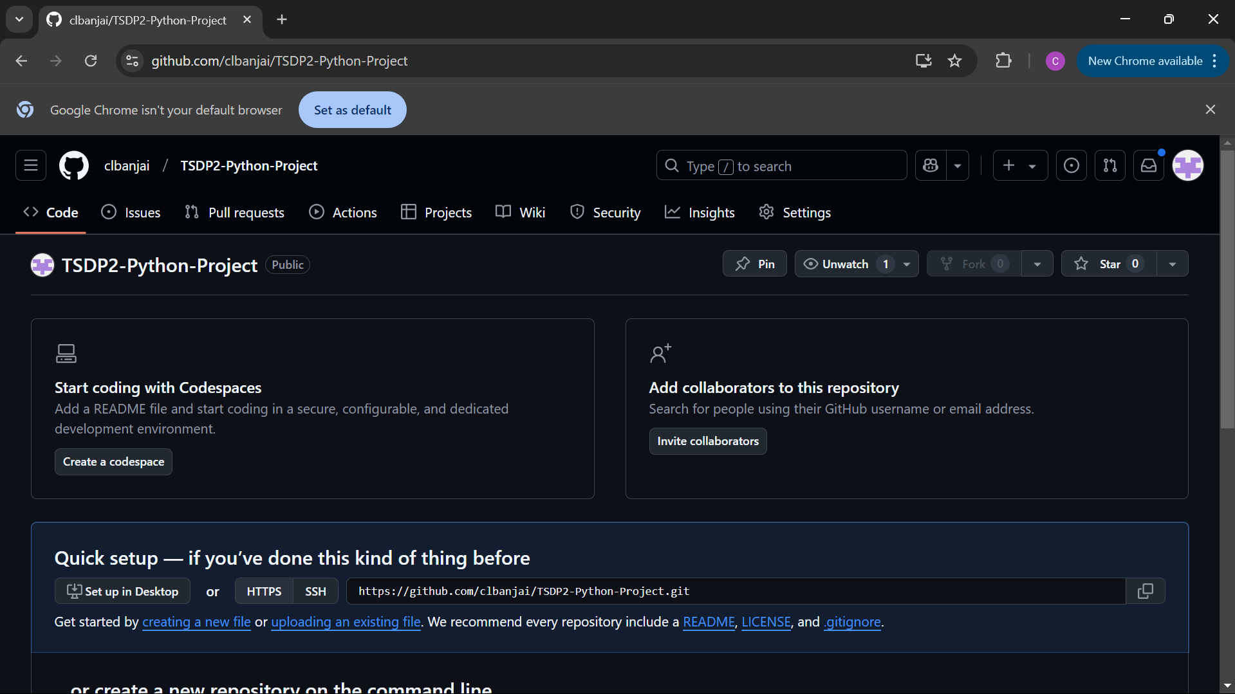
You can choose to work with someone else if you want to divide the task

Slide 16
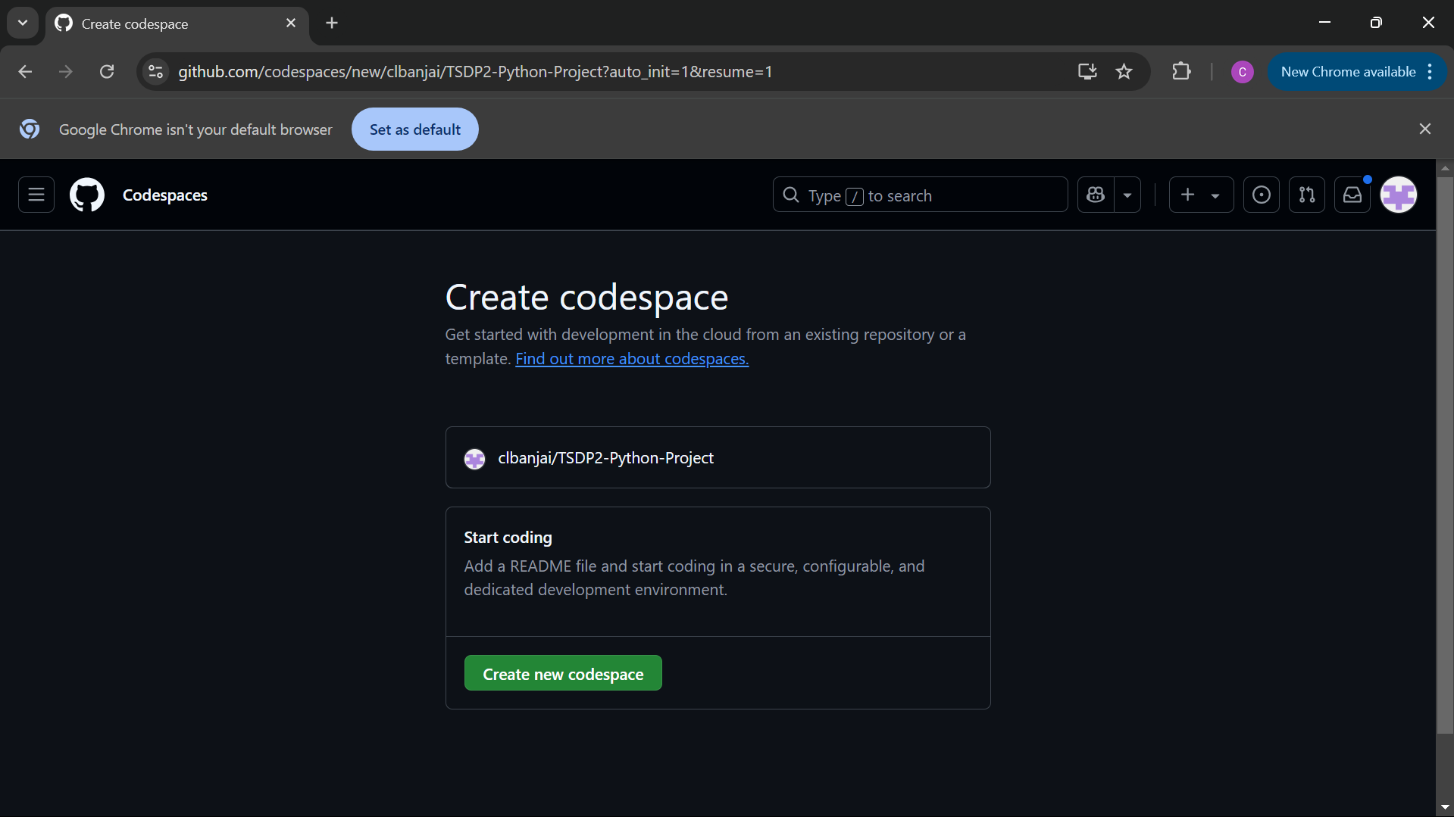

Slide 17
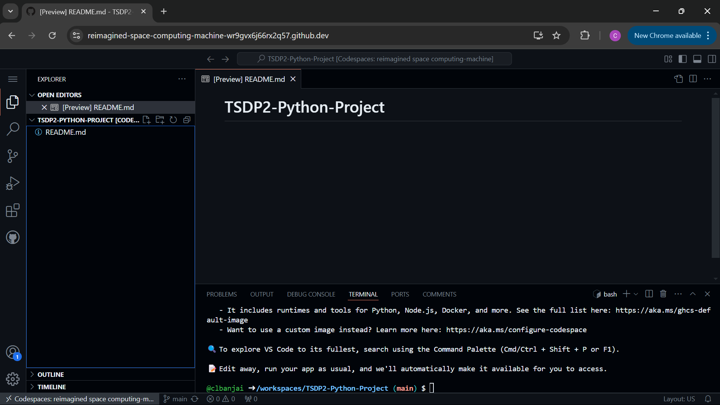

Slide 19
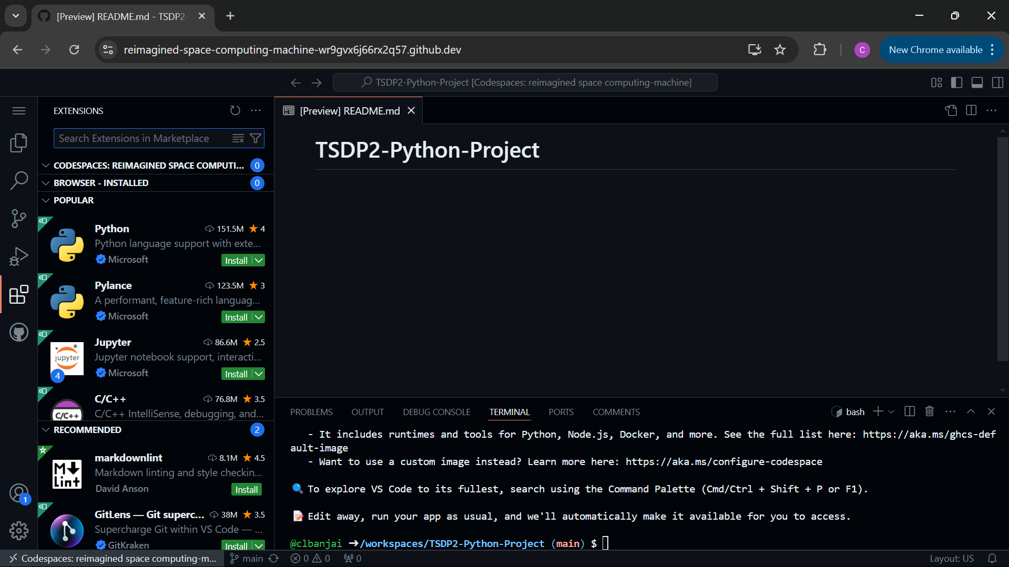

Slide 20
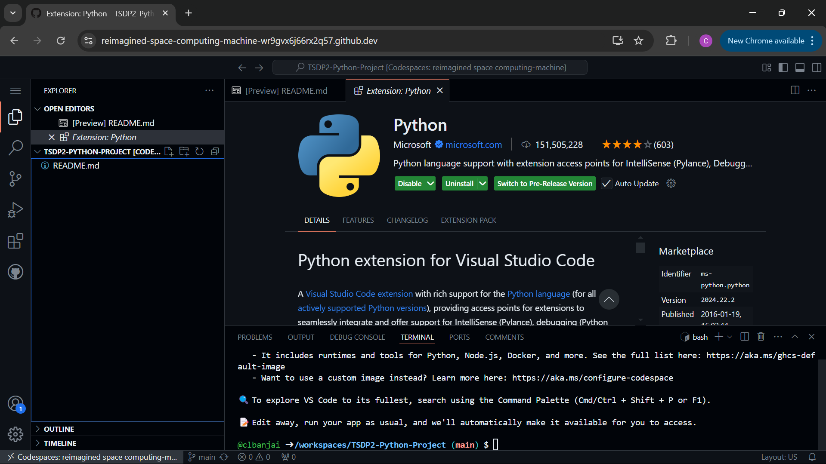
Create new folder
Create new file

Slide 21
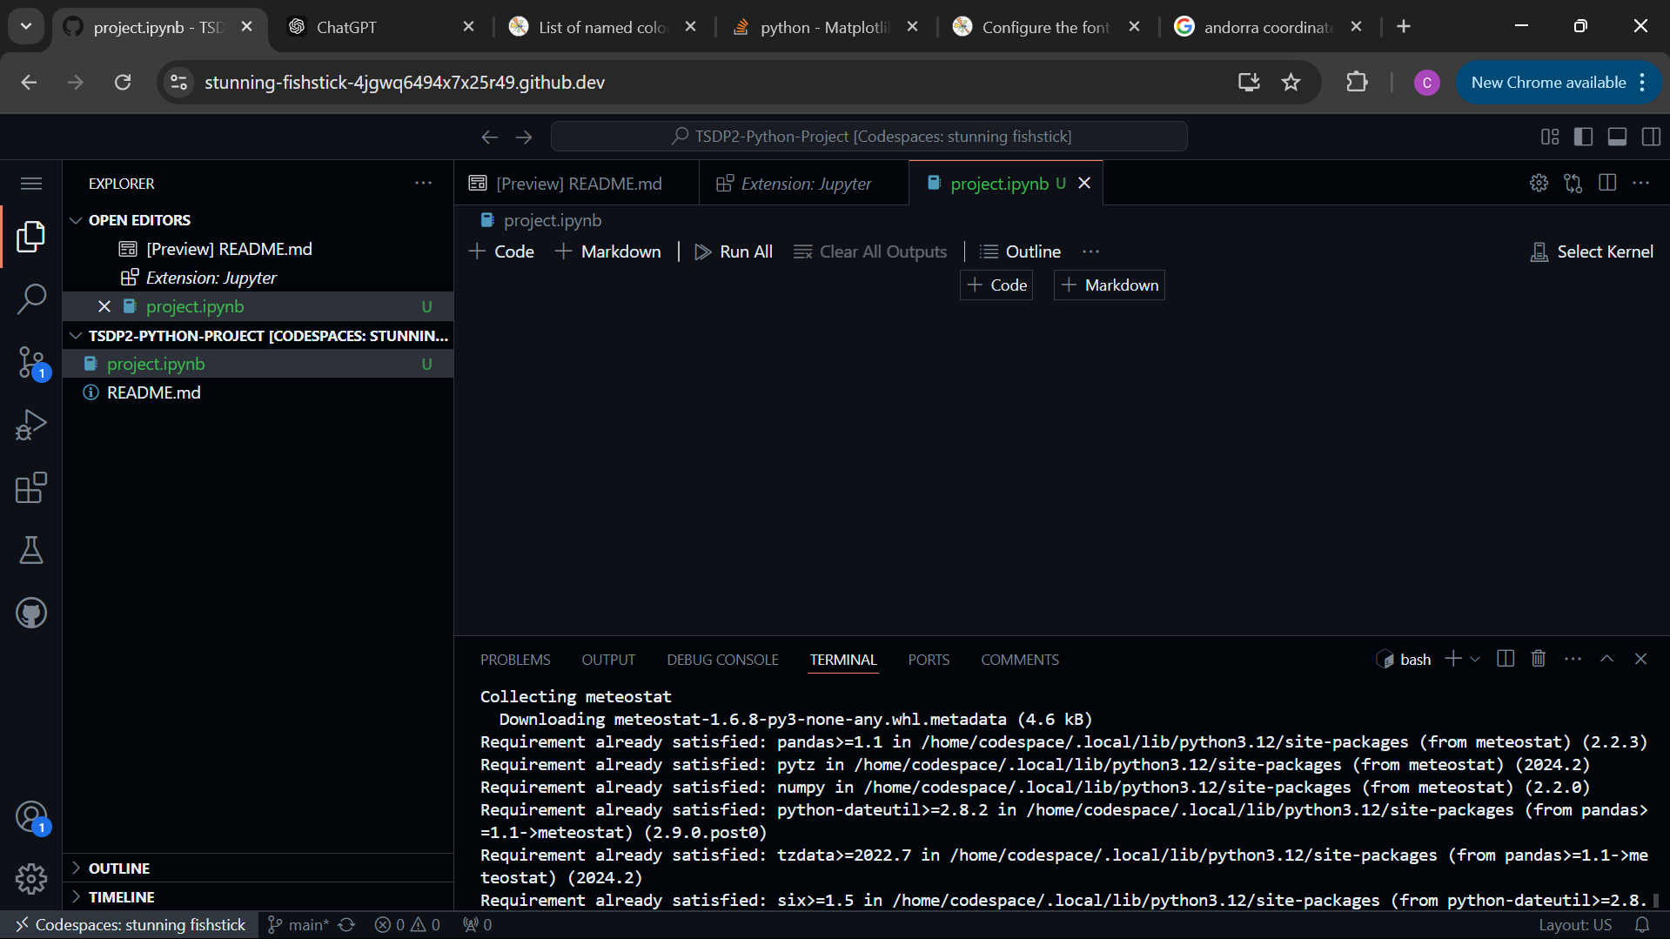
.ipynb

Slide 22
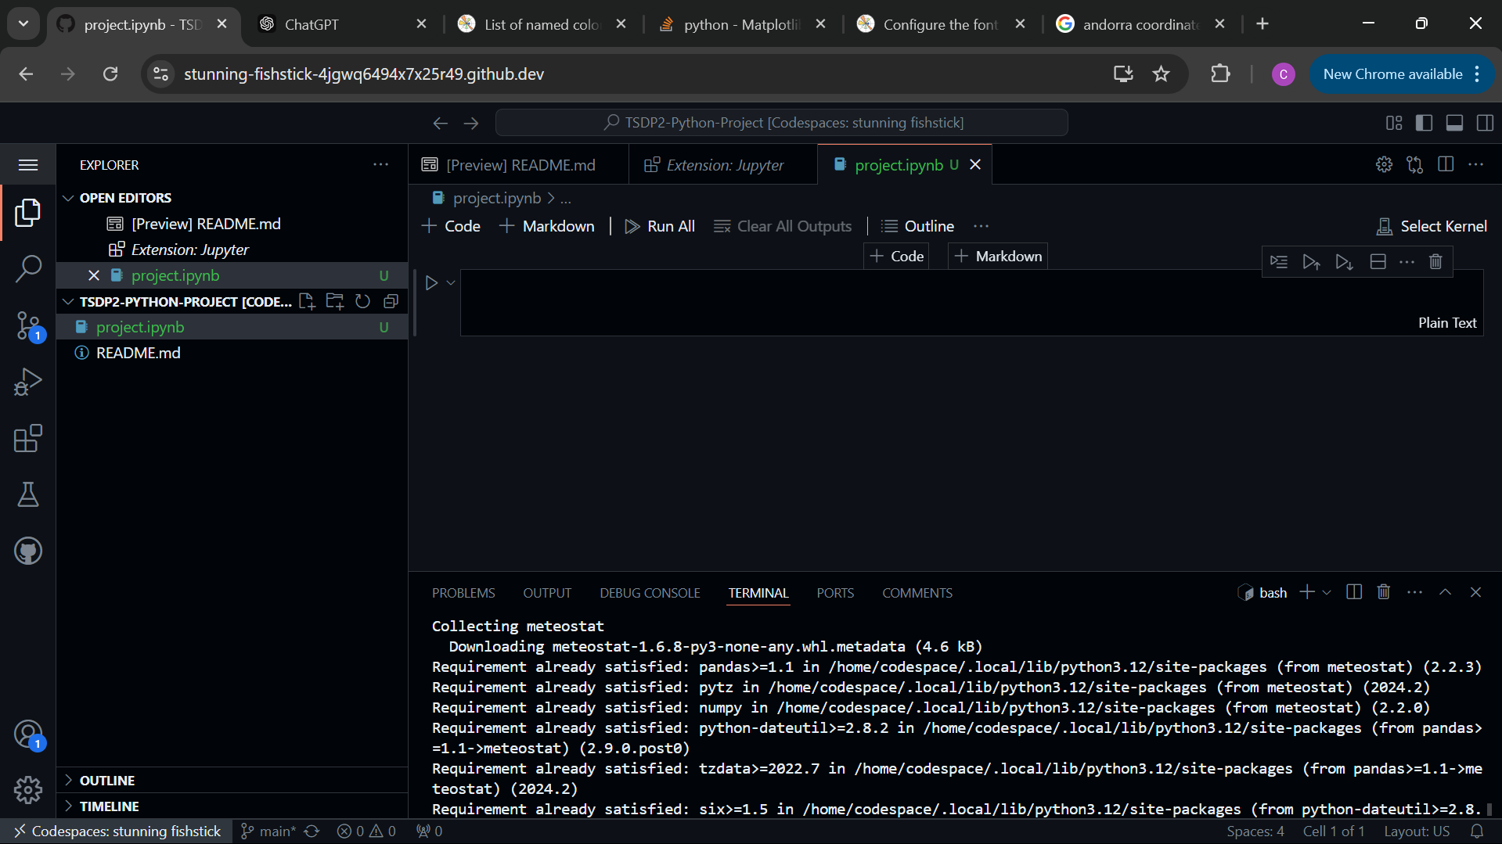

Slide 23
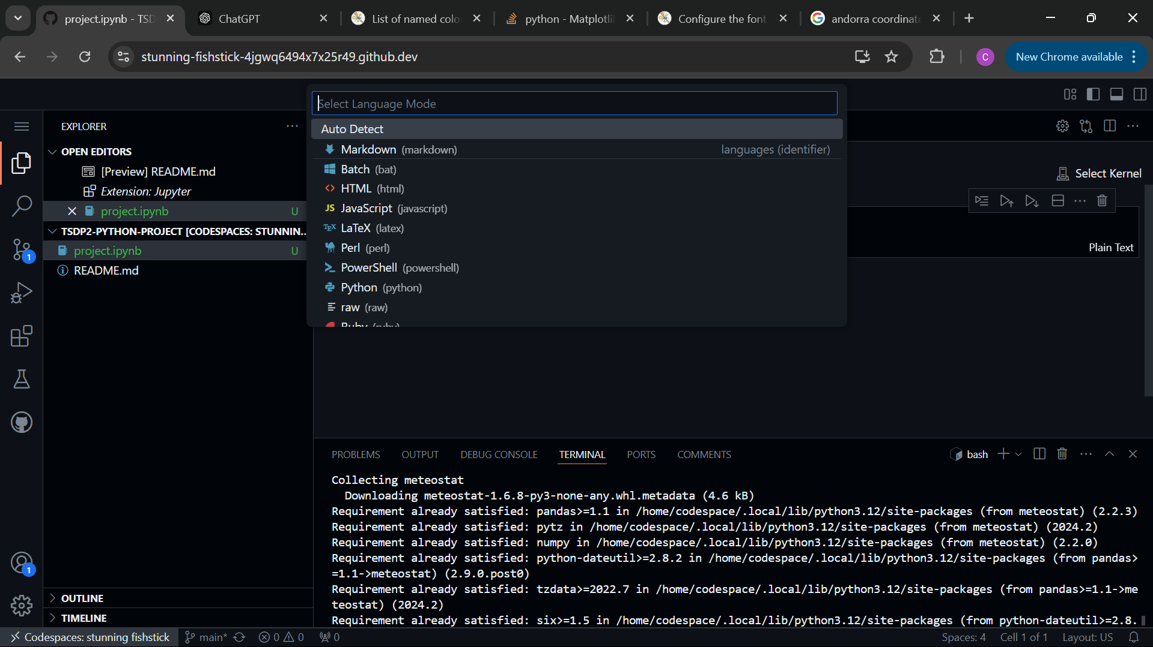

Slide 24
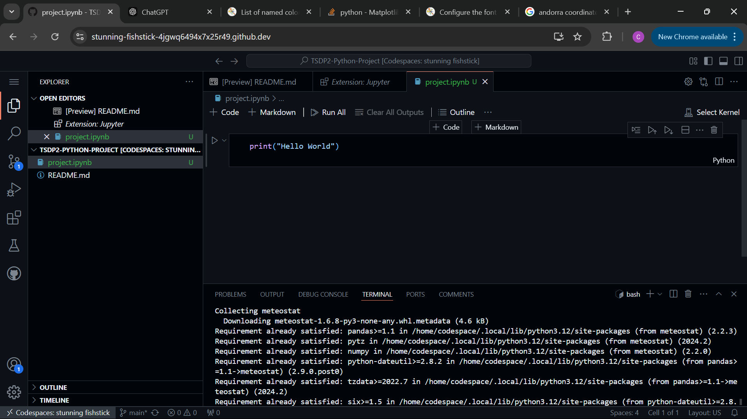

Slide 25
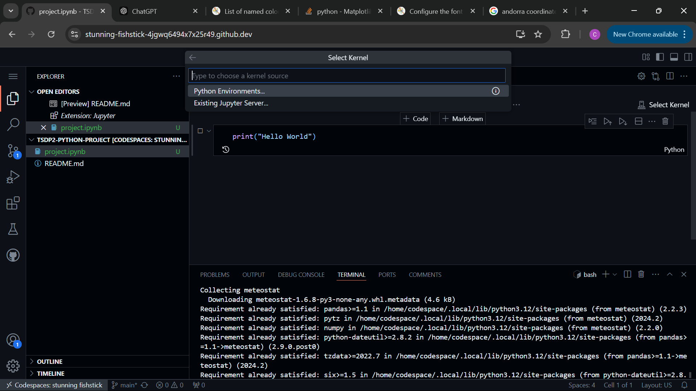

Slide 26
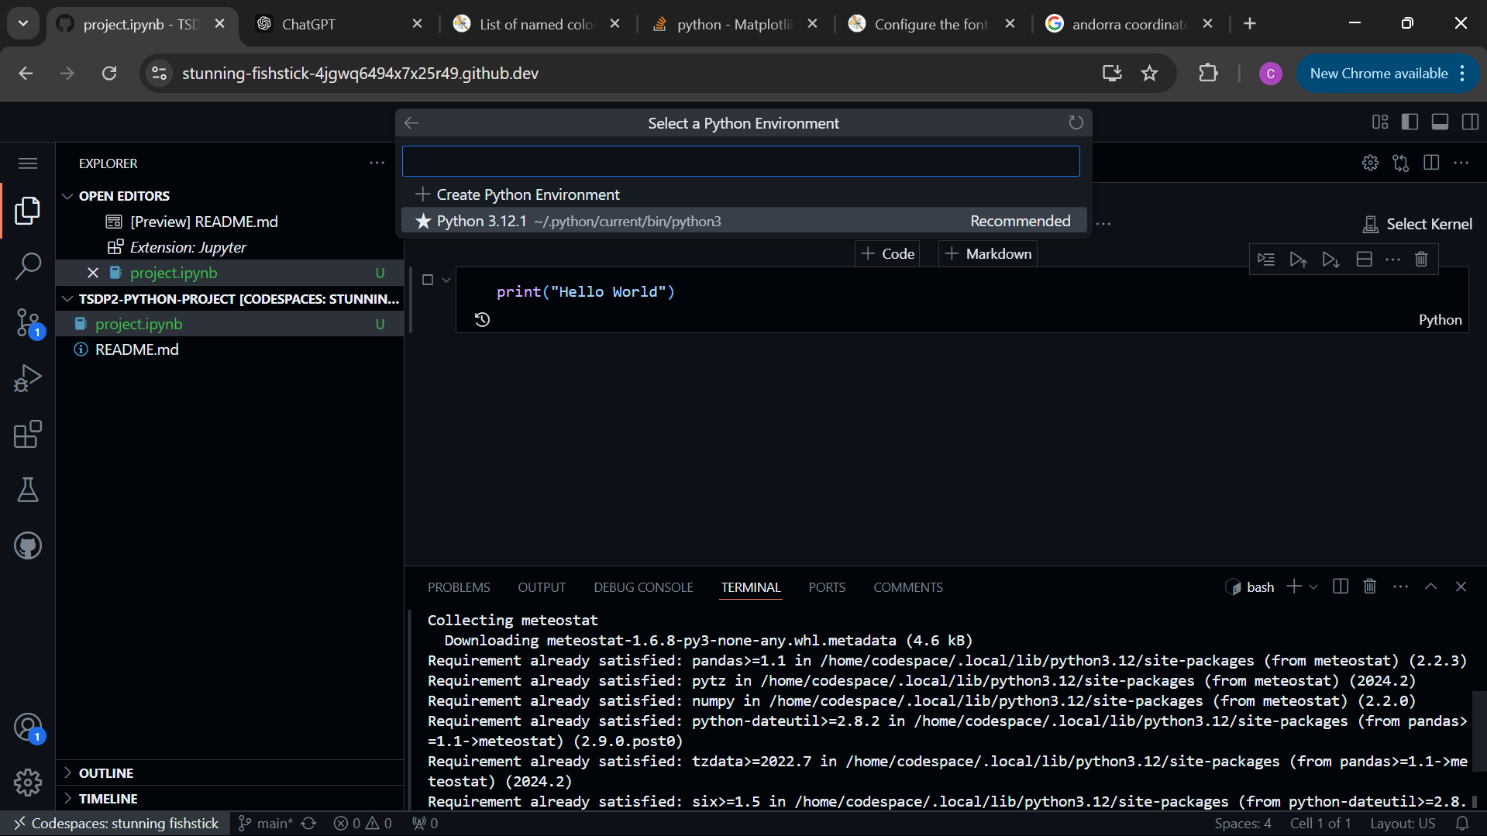

Slide 27
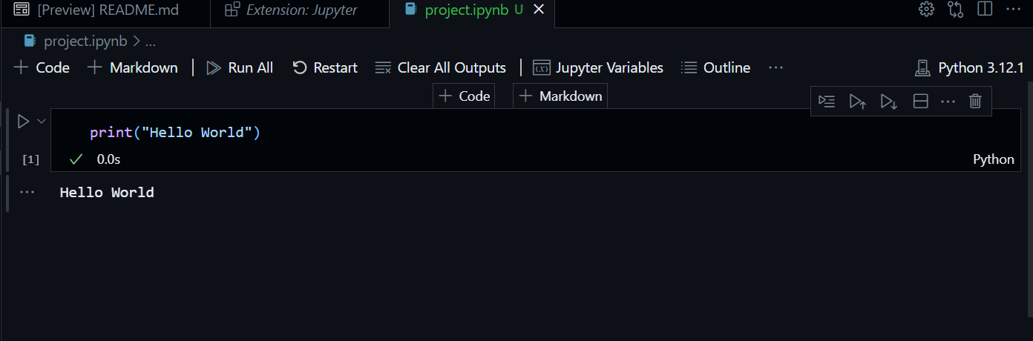


Slide 28
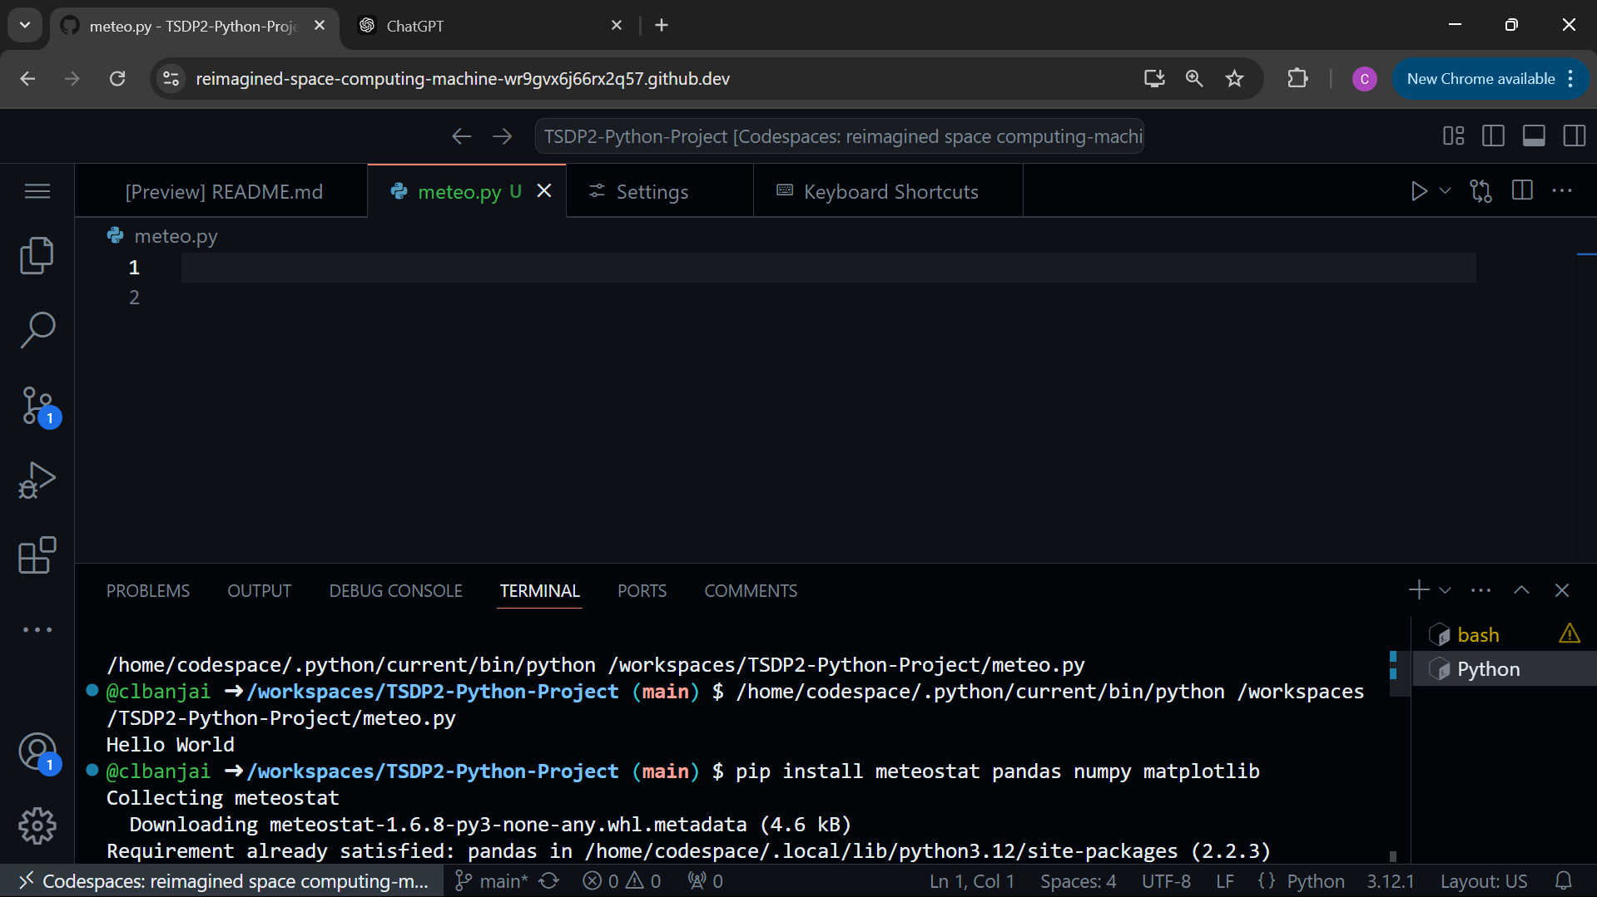

Slide 29
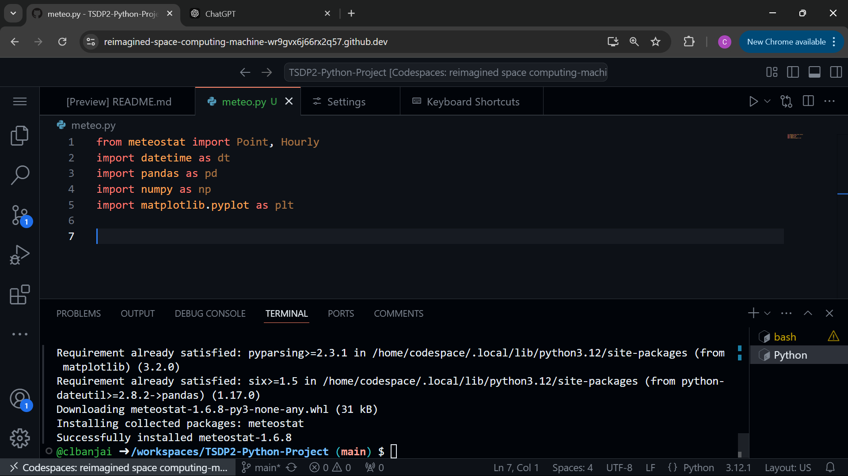

Slide 30
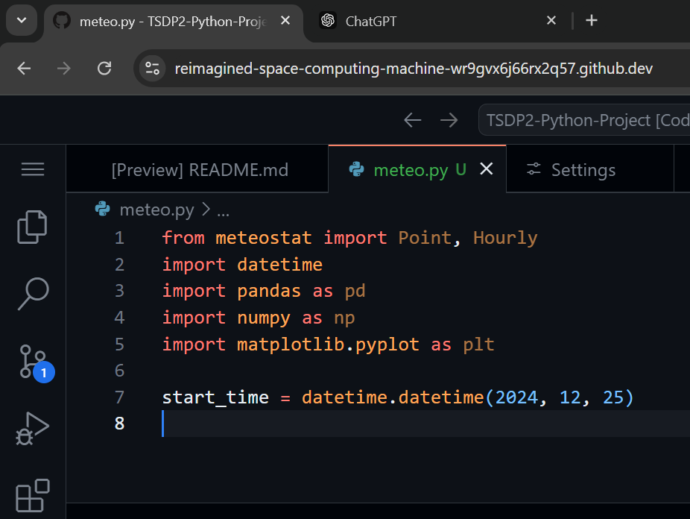
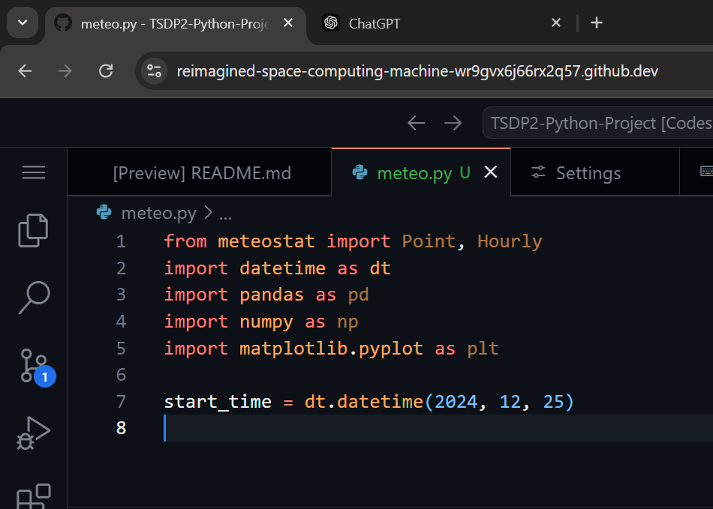
You can call the library however you want

Slide 31
Data analysis
Define the Objective
Collect the data
Explore and understand the data
Data cleaning
Transform the data
Analyze the Data
Interpret the results we’ll come back to this slide as we progress

Slide 32
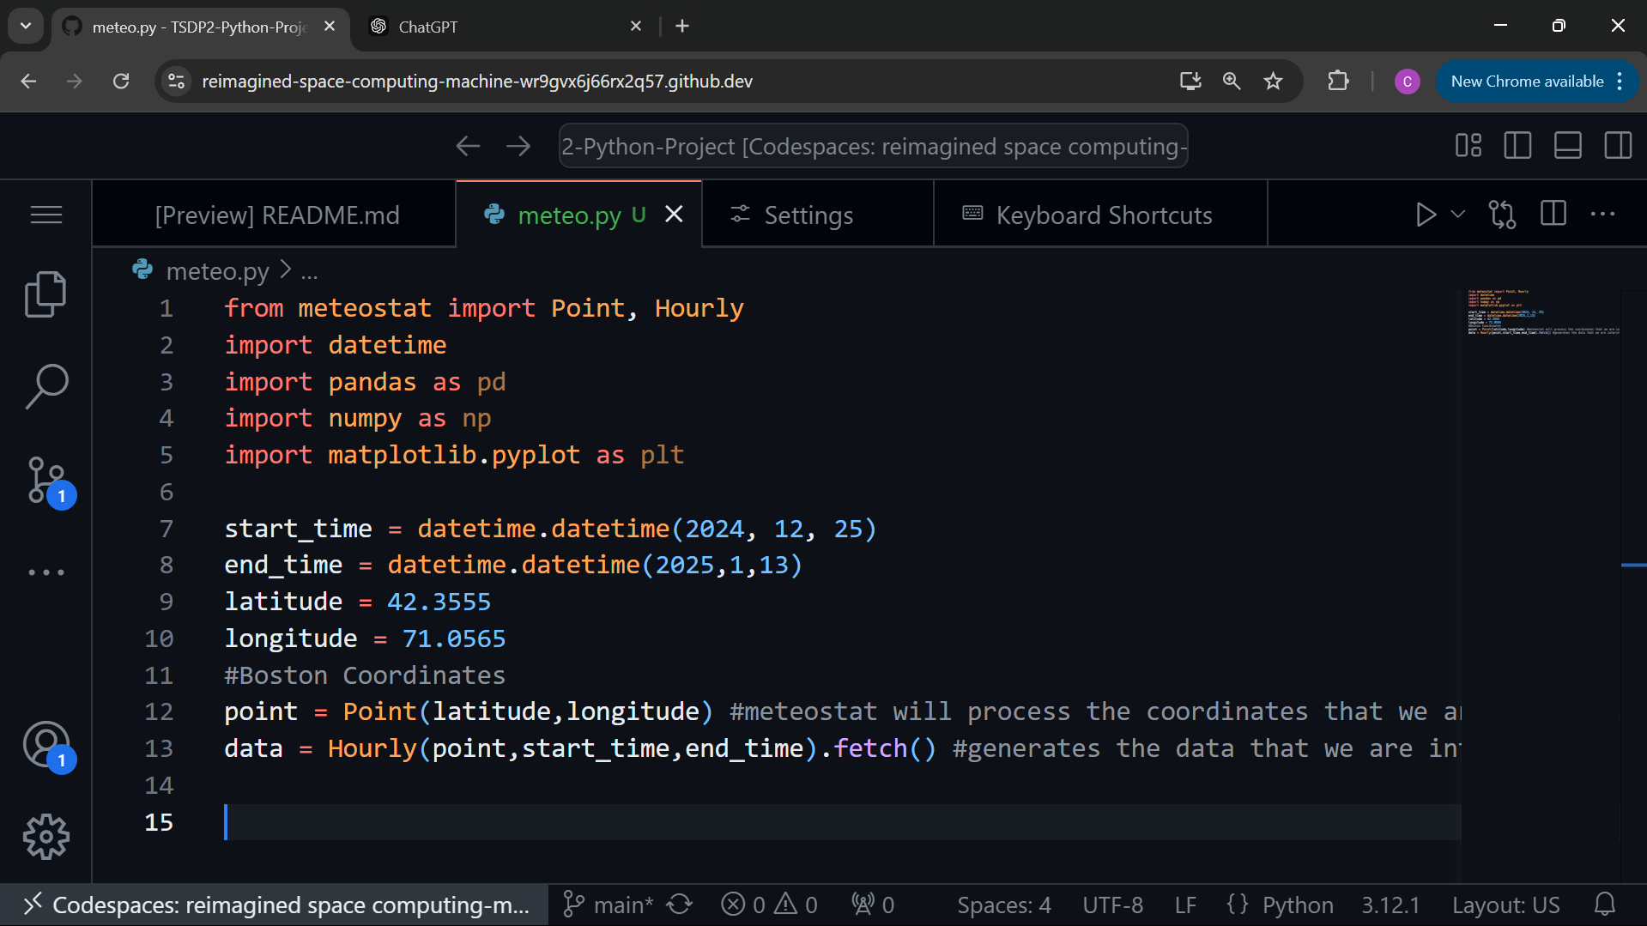

Slide 33
How do we know if it worked?

Slide 34
How do we know if it worked?
Print!!

Slide 35
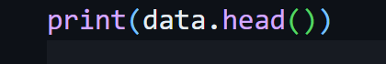
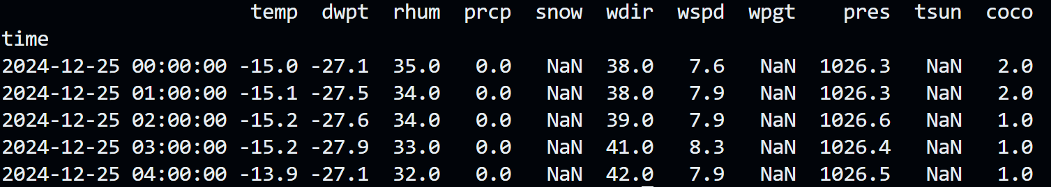
.head() allows you to access the top 5 rows of our data frame
We can see that it worked!

Slide 36
Data analysis
Define the Objective
Collect the data
Explore and understand the data
Data cleaning
Transform the data
Analyze the Data
Interpret the results we’ll come back to this slide as we progress

Slide 37
How big is our data set?

Slide 38

How big is our data set?

Slide 39
How big is our data set?
What are the elements of our data, what do they represent, what are the units?

Slide 40
How big is our data set?
What are the elements of our data, what do they represent, what are the units?
Code | Meaning
Temp | Air temperature
Dwpt | Dew Point
Rhum | Relative Humidity
Prcp | Precipitation
Snow | Snow
Wdir | Wind Direction
Wspd | Wind Speed
Wpgt | Wind Peak Gust
tsun | Total Sunshine Duration
Coco | Cloud Coverage

Slide 41
Not a number

Slide 42
Data analysis
Define the Objective
Collect the data
Explore and understand the data
Data cleaning
Transform the data
Analyze the Data
Interpret the results

Slide 43
Data cleaning
The process of identifying, correcting, or removing errors and inconsistencies in a dataset to make sure that the data is accurate, complete, and usable for analysis

Slide 44
Data cleaning
The process of identifying, correcting, or removing errors and inconsistencies in a dataset to make sure that the data is accurate, complete, and usable for analysis
What to do with those columns?

Slide 45
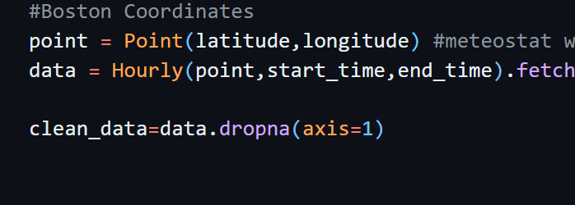
Data cleaning
Need to specify the axis
0 would mean rows
1 means columns
Pandas function to get rid of “NaN”

Slide 46
Data cleaning
How do we know if it worked?

Slide 47
Data cleaning
How do we know if it worked?
PRINT!!!!

Slide 48

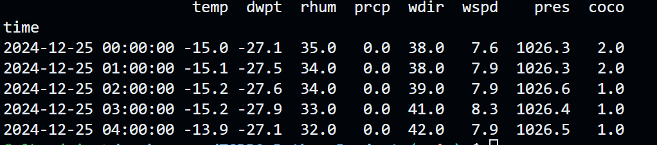
.head() allows you to access the top 5 rows of our data frame

Slide 49
.head() allows you to access the top 5 rows of our data frame
.head(n) allows you to access the top n rows of our data frame

Slide 50
Data analysis
Define the Objective
Collect the data
Explore and understand the data
Data cleaning
Transform the data
Analyze the Data
Interpret the results

Slide 51
Transforming data
In cases where our data is not exactly how we want it to be we need to manipulate slightly
Slicing and indexing, like with other python data types, allows you to extract a portion of the original data type
small_list = big_list[4:10]
dict_value = dictionary[‘key’]

Slide 52
Transforming data
Pandas has a different type of indexing method
column names (normally strings)

Slide 53
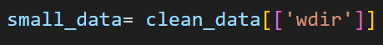
Transforming data
Pandas has a different type of indexing method
list the columns of interest

Slide 54
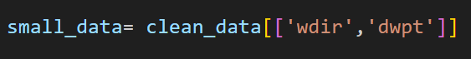
Transforming data
Pandas has a different type of indexing method

Slide 55
Transforming data
Pandas has a different type of indexing method
Not column, that is the row index

Slide 56
Transforming data
Pandas has a different type of indexing method

Slide 57
Transforming data
Pandas has a different type of indexing method

Slide 58
Data analysis
Define the Objective
Collect the data
Explore and understand the data
Data cleaning
Transform the data no need to transform the data (for now)
Analyze the Data
Interpret the results

Slide 59
Analyzing Data (visualization)
Allows you to take raw data and draw conclusions from it
It’s hard to understand something just with a long list of numbers
Find ways to help user visualize
Plotting is a common way of analyzing data

Slide 60
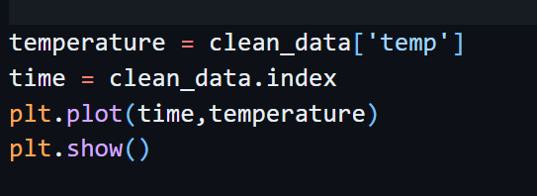
Plotting
Let’s say I want to see how the temperature changes over time
First, I need to extract the variables
Second, I need to convert them
And then we can plot!!

Slide 61
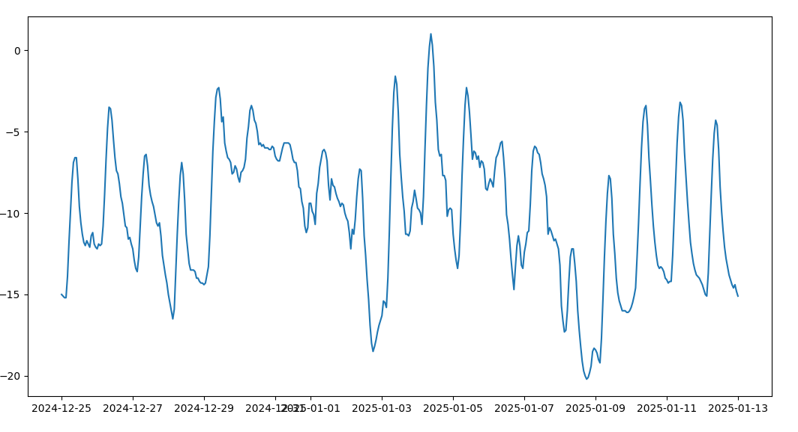
Plotting

